Slide 1
Mandated Reporting
Susann Clinton RN, FNP AFN-BC,
SANE-P, SANE-A
Children’s Justice Coordinator Coconino County

Slide 2

Mandated Reporting
  -What is Mandated reporting?

Slide 3
Arizona law that requires certain persons who believe that a child has received non-accidental injury, or believe that a child is victim of abuse, neglect, exploitation or abandonment to make a reasonable attempt to protect the child. This is done by contacting Department of Child Safety and/or Law Enforcement-IMMEDIATELY!

Slide 4
Two Laws
A.R.S. § 15-514
  Applies to educators
  Violations can result in disciplinary action
A.R.S. § 13-3620
  Applies to educators and others
  Revisions became effective September 18, 2003

Slide 5
A.R.S. § 15-514
A certificated person or governing board member who reasonably suspects or receives a reasonable allegation that a certificated person has engaged in conduct that would trigger A.R.S. § 13-3620 must inform Board of Education in writing within 3 business days.
Superintendent or chief administrator of a charter school shall report conduct to department of education.

Slide 6
Two Primary Categories of Mandatory Reporters
Persons who develop “reasonable belief” in the course of their duties.
Persons who develop “reasonable belief” at any time.

Slide 7
Must Report Based on Reasonable Belief Developed in the Course of Duties:
Employment
  School Personnel (even if the victim does not attend the same school)
  Domestic Violence Victim Advocate

Slide 8
Course of Duties
Treating a Patient:
  Nurse
  Psychologist
  Physician/Osteopath Optometrist
  Dentist
  Chiropractor/Podiatrist
  Behavioral Health Professional
  Counselor/Social worker
  Occupational, Physical or Speech Therapist

Slide 9
Must Report Based on Reasonable Belief Developed at any Time:
Peace Officer
Member of the Clergy
Priest
Christian Science Practitioner
Parent, stepparent, or guardian of the minor believed to have been abused
Any other person who has responsibility for the care or treatment of the minor

Slide 10
Who MAY Report?
Any person who reasonably believes that a minor is or has been a victim of physical or sexual abuse or neglect.

Slide 11
The Importance of Reporters
Those in mandated reporter positions are often the first to suspect abuse because you recognize behavioral changes in the child.
They may be the only responsible adult in a particular child’s life.
They are often the first persons to whom children disclose abuse to because of their relationship with a child.

Slide 12
When do I have to Report?
Mandatory Reporters
  Immediately by phone or in person.
  Shall be followed by a written report within 72 hours.
Discretionary Reporters
  No time limits – but why wait?

Slide 13
Arizona Standards for Reasonable Belief
“Reasonable belief” is a low standard
“[R]easonable grounds means that if there are ANY facts from which one could reasonably conclude that a child had been abused, the person knowing those facts is required to report.”
We do not believe our legislature intended persons with knowledge of alleged child abuse to conduct their own investigation to decide whether enough evidence of abuse exists to warrant a report.
Notes:
Example

Slide 14
Reasonable Belief
3 ways you can develop a reasonable belief:
1) A child discloses to you information.
2) A child has unexplained injuries or an explanation that is inconsistent with the injuries.
3) A third party discloses information that gives you reason to believe abuse or neglect has occurred.
  Is the third party credible? Do they have knowledge and are trustworthy?

Slide 15
Duty to Report is a
Personal Responsibility
Reporting to pastor, supervisor, principal, school nurse, youth protection advocate, etc., does NOT excuse your own responsibility to report (regardless of organization’s policy).
Failing to report is a criminal offense

Slide 16
Penalties for Failing to Report
  A mandated reporter who does not report a sexual offense can be charged with a Class 6 Felony
  up to 2 years in prison
  $150,000 fine (83% surcharge)
  A mandated reporter who does not report any other type of abuse can be charged with a Class 1 Misdemeanor
    up to 6 months in jail
    $2500 fine (83% surcharge)

Slide 17
Civil Immunity
A person who complies with this law is immune from any civil or criminal liability by reason of that action unless
  the person acted with malice; or,
  the person has been charged with or is suspected of abusing or neglecting the child or children in question.

Slide 18
If the following has not already been volunteered…
Ask the child ONLY these four questions:
  What happened?
  Who did this?
  Where did it happen?
  When did this happen?
Notes:
Do not stop a child from making a disclosure, but do not ask additional questions. CPS and law enforcement use forensic specialists to interview children to obtain all of the facts regarding the alleged abuse or neglect.
If the child gives you a narrative about the abuse, please DO NOT ask questions that the child has already clearly answered.
If the child does disclose in a narrative format, it is very important to ask the child ONLY 4 questions. Asking additional questions may contaminate a case.
1. What happened?
CPS and/or law enforcement need facts/background to open a case. This will help them determine what type of abuse has occurred and gives them guidance as to who needs to be notified.
2. Who did this to you?
CPS and/or law enforcement need to know who is abusing the child. This will indicate who needs to be notified: CPS or law enforcement or both.
3. Where were you when this happened?
This will help you determine which law enforcement agency you need to notify, as you will have to notify the agency where the crime occurred.
4. When did this happen?
This is important for response times; an abuse that occurred last night is going to get a quicker response than an abuse that occurred a year ago.
*Note: With younger children it may be difficult for them to give you the "WHEN" as they may not have an accurate sense of time, but do realize that you still have the obligation to take the information you have obtained and notify the appropriate agency as your mandate has been triggered to make a report.

Slide 19
Mandated Reporters are often the voice of abused children, because they often don’t tell!
Been told they won’t be believed
Think they are the only one
Afraid of foster care
Afraid the someone they care about will go to jail
Dependent/vulnerable
Feel responsible for abuse Love their abuser
Don’t realize that acts are abusive
Don’t know who to trust
Been threatened
Intimidated

Slide 20
Mandatory Reporters are the Voice for the Child
Reporting doesn’t necessarily mean that people will get arrested or children will get taken away from their parents!
Reporting means that the welfare of the child will be investigated and appropriate action will be taken to ensure their safety
You may be the only advocate the child has at the time

Slide 21
How to report
Reports of in-home abuse are made to Department of Child Safety/DCS
Reporting on-line: 1-888-SOS-CHILD or dcs.az.gov
Reports of abuse involving an alleged perpetrator who lives outside the home should be made to the appropriate Law Enforcement Agency
You should report to both if the child is in immediate danger and a quick response is needed
When in doubt—Report to Law Enforcement

Slide 22
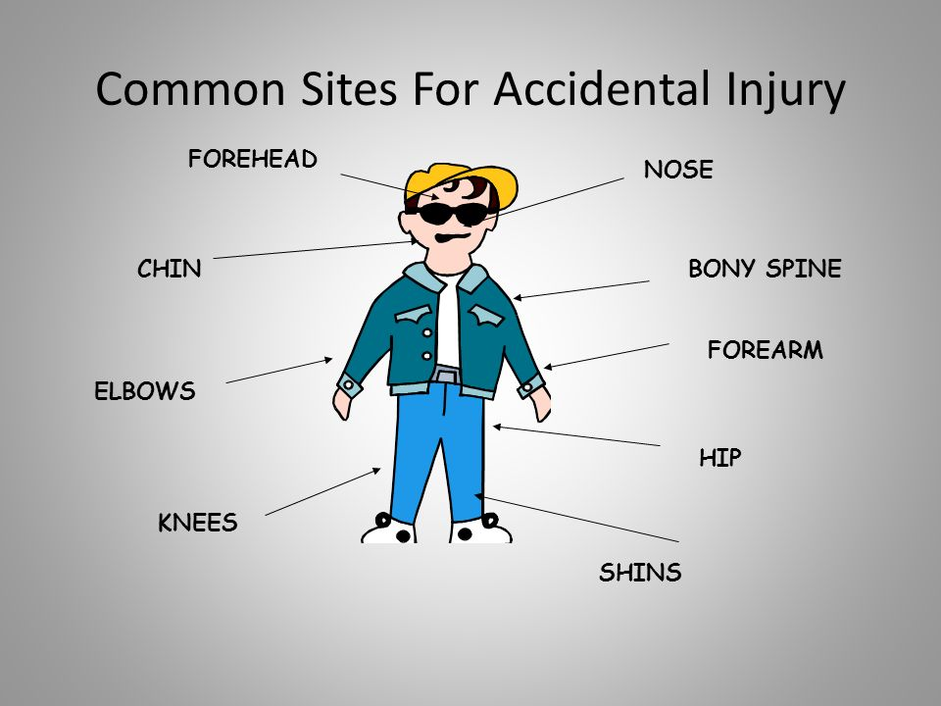

Slide 23
Sexual Abuse
Any sexual act between an adult and minor or between minors when one exerts power over the other.
It also includes non-contact acts such as exhibitionism, exposure to pornography, voyeurism, and communicating in a sexual manner by phone or internet.

Slide 24
Sexual Abuse Indicators
Behaviors
Sexual knowledge inappropriate for age
Eating disorders
Aggression
Substance abuse
Self-abusive behavior
Sexually acting out with younger children
Change in behavior

Slide 25
Sexual Abuse Exception
You are not mandated to report Sexual Abuse, IF:
1) BOTH parties are 14, 15, 16, or 17 years old, AND
2) There is nothing to indicate the sexual conduct is anything other than consensual.
BUT, you MAY report it and immunity will apply.

Slide 26
Emotional Abuse
“Serious emotional damage” evidenced by “severe anxiety, depression, withdrawal or untoward aggressive behavior” AND which is “diagnosed by a medical doctor or psychologist” AND is “caused by the acts or omissions” of the caregiver.
Visible signs of emotional abuse in children can be difficult to detect and to prosecute.

Slide 27
Emotional Abuse Indicators
Learning disabilities
Sleep disorders
Poor social skills
Unusually fearful
Stuttering
Baby talk
Unresponsive
Hyperactive

Slide 28
Neglect
Neglect is the inability or unwillingness of a parent or caregiver of a child to provide shelter, food, appropriate clothing, or medical care if that inability or unwillingness causes a substantial risk of harm to the child’s health or welfare.

Slide 29
Neglect
Failure to provide these basics needs to be chronic in order for the abuse to be considered “neglect.”
Poverty and lifestyle choices are not signs of neglect.

Slide 30
Neglect Behavioral Indicators
Begging or stealing food
Difficulty with hearing or vision
Poor coordination
Acting out
Frequent visits to the school nurse

Slide 31
Let’s Practice
You ask, “……….?”

Slide 32
Child says, “ I got hit.”
What can you ask?

Slide 33
You ask, “…………..,
“Last night at home my
dad hit me because I
was late.”
What do you need to ask?
You will need from other sources if possible:
1. The child’s name and address.
2. The caregiver’s name and address.
3. Gather the nature and extent of the abuse or neglect.
4. Obtain any other information that might be helpful.

Slide 34



Slide 35
Safe Child Center
Child Advocacy Center
Flagstaff Medical Center
Understanding the benefits of Child Advocacy Centers (CACs) aids is reporting

Slide 36
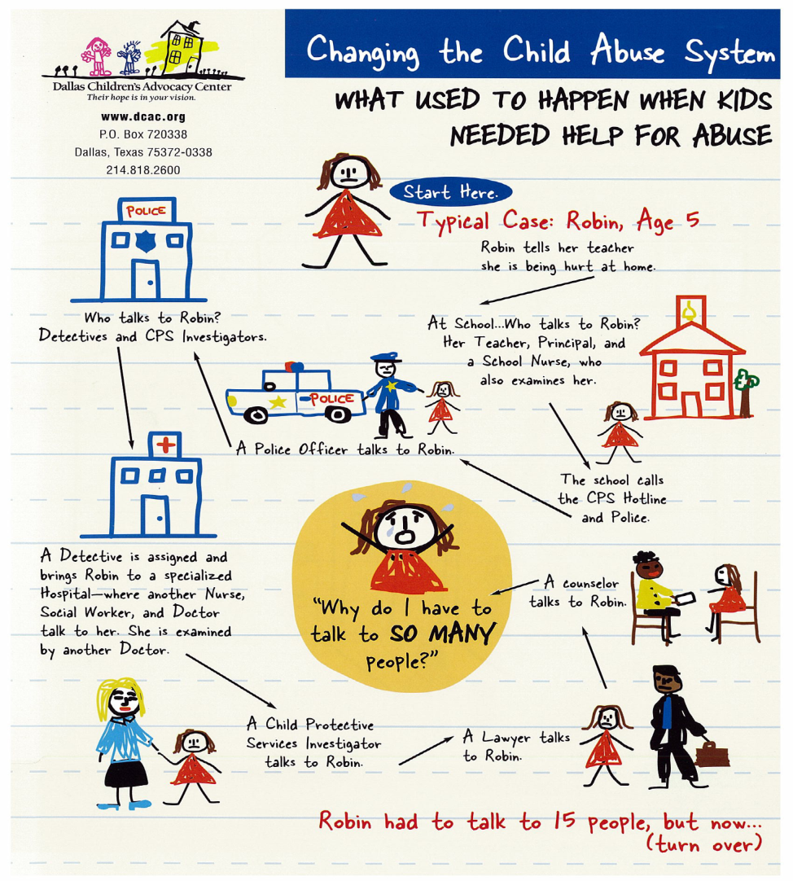
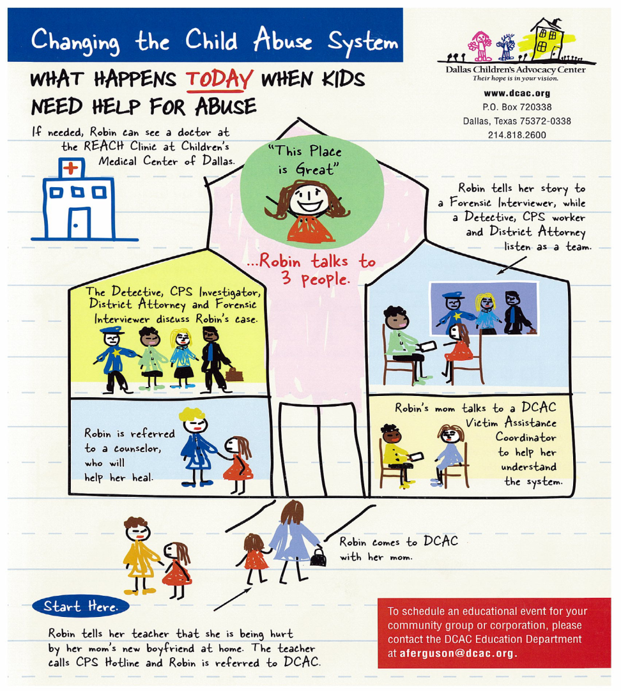
What is a CAC?

Slide 37
An Advocacy Center is….
Progressive environment for professionals
Safe Child friendly environment for victims
Collaborative effort
Peer review and oversight
Operates in accordance with “Best Practice” standards identified by National Children’s Alliance

Slide 38
MDT Investigations
  Role of Law Enforcement
  Role of DCS
  Role of Victim Witness Services
  Role of Prosecution

Slide 39
At Safe Child Center
Forensic interviews
Medical exam
Family advocacy
Behavioral health therapists

Slide 40
Answers to the quiz!
A mandated reporter who does not report a sexual offense can be charged with a Class 6 Felony offense
Get the Who, What, When, Where answered!
Law/Peace officers & members of the clergy
          All children, All the time
          Always on Duty
Persons whose jobs or professions impose a duty to report information received during the course of their employment.
    Physicians, PAs, Optometrists, Dentists, Nurses, Chiropractors, Podiatrists, Counselors, School Personnel, Domestic Violence Victim Advocates
    Some of the time, All children

Slide 41
Safe Child Center
Where the voice of a child gets the attention it deserves

