Slide 1
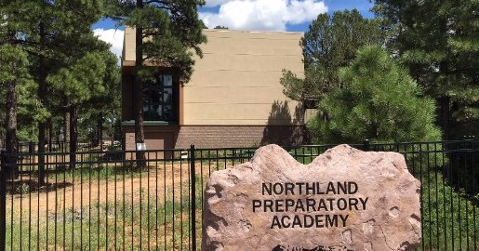
NPA Governing Board Meeting
FEBRUARY 22nd, 2021
5:30 PM

Slide 2
Return to In-Person Instruction Recommendation
Lykins/litwicki

Slide 3
Preparing for In-person Learning
Tier 2 Team Members
2 Middle School
2 High School
1 MS&HS
Departments:
ELA, SS, Math, Science, Fine Arts
Tech
Counselling
2 Administrators
Tier 2 Team Meetings:
February 9th
February 17th
Leadership Team Meetings:
February11th
February 18th

Slide 4
Tier 2 Team Considerations
COHORT INSTRUCTION
Split students into cohorts
In-person 2 days, remote 2 days
4 lessons a week
Wednesdays off
Allows small class sizes
OPEN RETURN
All students welcome
Concurrent streaming provided
5 days a week
Mitigation more difficult
Note: Technology concerns transcend either model

Slide 5
Tier 2 Preference
If we return to In-person Instruction, then the Tier 2 Team believes it is best to return 5-days a week with concurrent on-line instruction.
Send a parent communique to commit to a choice: In-person/On-line
Create a process for those who choose to switch either way
Understanding that any return should be contingent on benchmark data

Slide 6
Phased Return
March 8-12th: Teachers set up classrooms for return to in-person instruction (most already have)
March 11th: Special Board Meeting
March 15-19th: Spring Break
March 22-26th: All teachers return to NPA to teach Zoom classes from the NPA buildings (ascertain and iron out tech challenges)
March 29-April 2nd: Return to in-person instruction- Grades 6, 8 , 9, 12 (& specialized programs)
April 5-9th: Return to in-person instruction- Grades 7, 10, 11

Slide 7
Benefits to 5 Day Return
Continuity for students
More quicky reacclimate students to in-person education
More quickly gauge student levels
Allow for better informed planning for possible remediation in 21/22 SY
Does not require teachers to learn a whole new skill set (again)
Easier to plan for and administer State standardized tests in April
*AIMS Science & AZM2
*AP testing

Slide 8
Challenges for 5 Day Return
7 zooms 5 days a week for concurrent students
Small classrooms (6 foot distancing)
More challenging mitigation protocols
Health Checks
Contact tracing
Distancing outside of classroom
Students moving between modalities

